Slide 1
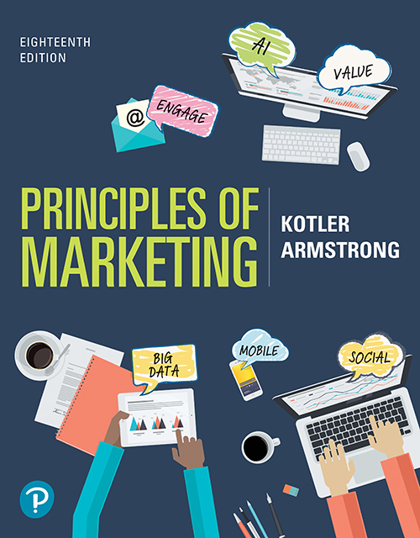
Principles of Marketing
Eighteenth Edition
Chapter 10
Pricing: Understanding and Capturing Customer Value
Copyright © 2021, 2018, 2016 Pearson Education, Inc.
Notes:
If this PowerPoint presentation contains mathematical equations, you may need to check that your computer has the following installed:
1) Math Type Plugin
2) Math Player (free versions available)
3) NVDA Reader (free versions available)

Slide 2
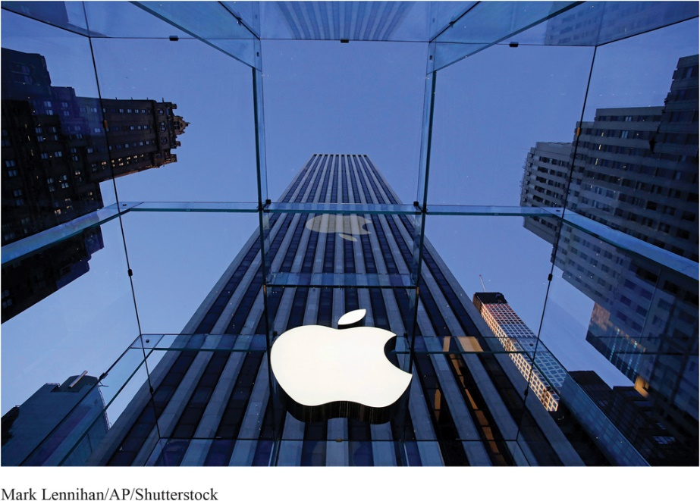
APPLE: Premium Priced and Worth It?
Apple has always set its prices way above those of competitors, reaping the rewards of higher revenues and profits. But as Apple faces stiffer global competition from lower-priced brads, some customers may be questioning just how much more they are willing to pay for the iconic brand.
Avid fans have long anointed Apple as the keeper of all things cool, believing deep down that the value they receive is worth the premium price.
Notes:
Apple is the prototypical premium pricer. However, Apple’s products sell regardless of the high prices. Apple sells an experience. Its ability to command higher prices has produced stunning revenue and profit results, making Apple one of the largest and most valuable companies in the world.

Slide 3
Learning Objectives
10.1 Answer the question “What is a price?” and discuss the importance of pricing in today’s fast-changing environment.
10.2 Define price, identify the three major pricing strategies, and discuss the importance of understanding customer-value perceptions, company costs, and competitor strategies when setting prices.
10.3 Identify and define the other important external and internal factors affecting a firm’s pricing decisions.

Slide 4
Learning Objective 1
Answer the question “What is a price?” and discuss the importance of pricing in today’s fast-changing environment.

Slide 5
What Is a Price?
Price is the amount of money charged for a product or service, or the sum of all the values that customers exchange for the benefits of having or using the product or service.
Notes:
Discussion Question
How does a company like Starbucks price their products?
This will lead to a good overview of the chapter as students will most likely focus on customers, costs, and competitors.
Historically, price has been the major factor affecting buyer choice. In recent decades, however, nonprice factors have gained increasing importance. Even so, price remains one of the most important elements that determines a firm’s market share and profitability.
In the narrowest sense, price is the amount of money charged for a product or a service. More broadly, price is the sum of all the values that customers give up to gain the benefits of having or using a product or service.
Price is the only element in the marketing mix that produces revenue; all other elements represent costs.
Price is also one of the most flexible marketing mix elements; prices can be changed quickly. Smart managers treat pricing as a key strategic tool for creating customer value and building customer relationships. Prices have a direct impact on a firm’s bottom line.

Slide 6
Learning Objective 2
Define price, identify the three major pricing strategies, and discuss the importance of understanding customer-value perceptions, company costs, and competitor strategies when setting prices.

Slide 7
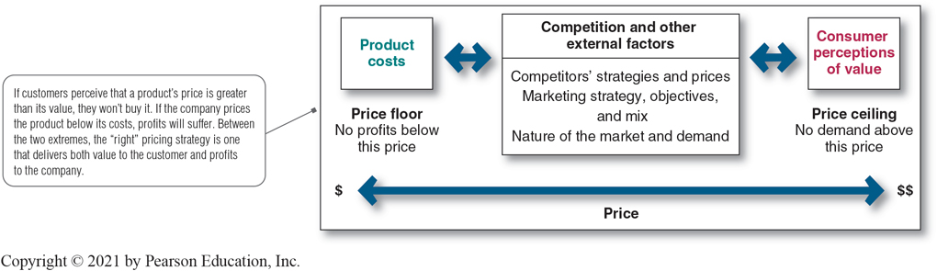
Major Pricing Strategies (1 of 17)
Figure 10.1 Considerations in Setting Price
Notes:
Figure 10.1 suggests three major pricing strategies: customer value-based pricing, cost-based pricing, and competition-based pricing.
The price the company charges will fall somewhere between one that is too low to produce a profit and one that is too high to produce any demand.
Figure 10.1 summarizes the major considerations in setting price. Customer perceptions of the product’s value set the ceiling for prices. Likewise, product costs set the floor for a product’s price.
In setting its price between these two extremes, the company must consider several external and internal factors, including competitors’ strategies and prices, the overall marketing strategy and mix, and the nature of the market and demand.
Long Description
The three boxes in the figure show the following text:
Product costs
Competition and other external factors: Competitors’ strategies and prices; Marketing strategy, objectives, and mix; Nature of the market and demand.
Consumer perceptions of value
The center box is connected to boxes on either side by double-headed arrows.
A long double-headed arrow at the bottom of the figure is labeled "Price." The left corner of it has a single dollar symbol with the text: "Price floor: No profits below this price" and the right corner of it has two dollar symbols with the text: "Price ceiling: No demand above this price."
If customers perceive that a product’s price is greater than its value, they won’t buy it. If the company prices the product below its costs, profits will suffer. Between the two extremes, the "right" pricing strategy is one that delivers both value to the customer and profits to the company.

Slide 8
Major Pricing Strategies (2 of 17)
Customer Value-Based Pricing
Value-based pricing uses the buyers’ perceptions of value rather than the seller’s cost.
Value-based pricing is customer driven.
Cost-based pricing is product driven.
Price is set to match perceived value.
Notes:
Note to Instructor
Students often confuse value with low price. You might want to bring up a product that some of them will value even at a high price. You can bring up the latest iPhone product or a luxury car. Some students will feel that the price for these products is too high, however, others will see the value these products offer to the consumer.
Customer Value-Based Pricing
In the end, the customer will decide whether a product’s price is right. Pricing decisions, like other marketing mix decisions, must start with customer value. Effective customer-oriented pricing involves understanding how much value consumers place on the benefits they receive from the product and setting a price that captures that value.
Figure 10.2 (shown on the next slide) compares value-based pricing with cost-based pricing. Although costs are an important consideration in setting prices, cost-based pricing is often product driven and sets a price that covers costs plus a target profit. Marketing must then convince buyers that the product’s value at that price justifies its purchase. If the price turns out to be too high, the company must settle for lower markups or lower sales, both resulting in disappointing profits.
In the end, the customer will decide whether a product’s price is right. Pricing decisions, like other marketing mix decisions, must start with customer value. When customers buy a product, they exchange something of value (the price) to get something of value (the benefits of having or using the product). Effective, customer-oriented pricing involves understanding how much value consumers place on the benefits they receive from the product and setting a price that captures that value.

Slide 9
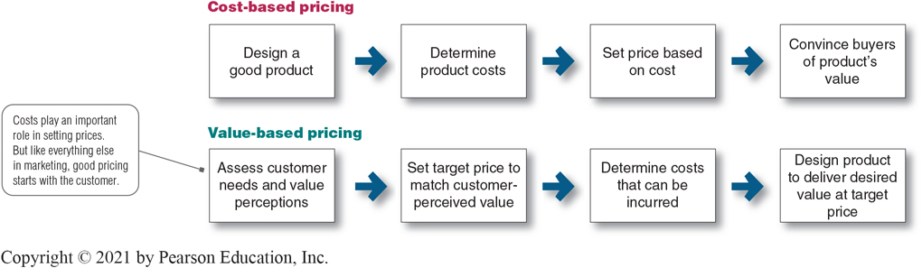
Major Pricing Strategies (3 of 17)
Figure 10.2 Value-Based Pricing versus Cost-Based Pricing
Notes:
Long Description
The flowchart shows the following information:
Cost-based pricing shows the following steps:
Design a good product
Determine product costs
Set price based on cost
Convince buyers of product’s value.
Value-based pricing shows the following steps:
Assess customer needs and value perceptions
Set target price to match customer-perceived value
Determine costs that can be incurred
Design product to deliver desired value at target price.
Costs play an important role in setting prices. But like everything else in marketing, good pricing starts with the customer.

Slide 10
Major Pricing Strategies (4 of 17)
Customer Value-Based Pricing
Good-value pricing is offering just the right combination of quality and good service at a fair price.
Notes:
The Great Recession of 2008 to 2009 caused a fundamental and lasting shift in consumer attitudes toward price and quality. In response, many companies have changed their pricing approaches to bring them in line with changing economic conditions and consumer price perceptions.
More and more, marketers have adopted the strategy of good-value pricing—offering the right combination of quality and good service at a fair price. In many cases, this has involved introducing less-expensive versions of established brand name products or new lower-price lines.
In other cases, good-value pricing has involved redesigning existing brands to offer more quality for a given price or the same quality for less. Some companies even succeed by offering less value but at very low prices. For example, the ALDI supermarket chain has established an impressive good-value pricing position by which it gives customers “more ‘mmm’ for the dollar.” ALDI practices everyday low pricing (EDLP).
EDLP involves charging a constant, everyday low price with few or no temporary price discounts. The king of EDLP is Walmart, which practically defined the concept.

Slide 11
Major Pricing Strategies (5 of 17)
Customer Value-Based Pricing
Everyday low pricing (E D L P) involves charging a constant everyday low price with few or no temporary price discounts.
Notes:
Good-value pricing: ALDI keeps costs low so that it can offer customers “impressively high quality at impossibly low prices” every day.

Slide 12
Major Pricing Strategies (6 of 17)
Customer Value-Based Pricing
High-low pricing involves charging higher prices on an everyday basis but running frequent promotions to lower prices temporarily on selected items.
Notes:
Department stores such as Sears and Macy’s practice high-low pricing by having frequent sale days, early-bird savings, and bonus earnings for store credit-card holders.

Slide 13
Major Pricing Strategies (7 of 17)
Customer Value-Based Pricing
Value-added pricing attaches value-added features and services to differentiate a company’s offers and thus their higher prices.
Notes:
Value-based pricing doesn’t mean simply charging what customers want to pay or setting low prices to meet competition. Instead, many companies adopt value-added pricing strategies rather than cut prices to match competitors.
For example, even as frugal consumer spending habits linger, some movie theater chains are adding amenities and charging more rather than cutting services to maintain lower admission prices.

Slide 14
Major Pricing Strategies (8 of 17)
Cost-Based Pricing
Cost-based pricing sets prices based on the costs for producing, distributing, and selling the product plus a fair rate of return for effort and risk.
Notes:
Whereas customer-value perceptions set the price ceiling, costs set the floor for the price that the company can charge.
Some companies, such as Walmart or Southwest Airlines, work to become the low-cost producers in their industries. Companies with lower costs can set lower prices that result in smaller margins but greater sales and profits. However, other companies—such as Apple, BMW, and Steinway—intentionally pay higher costs so that they can add value and claim higher prices and margins.

Slide 15
Major Pricing Strategies (9 of 17)
Cost-Based Pricing
Fixed costs are the costs that do not vary with production or sales level.
Rent
Heat
Interest
Executive salaries
Notes:
Fixed costs (also known as overhead) are costs that do not vary with production or sales level.

Slide 16
Major Pricing Strategies (10 of 17)
Cost-Based Pricing
Variable costs vary directly with the level of production.
Raw materials
Packaging
Notes:
Variable costs vary directly with the level of production. Each PC produced by HP involves a cost of computer chips, wires, plastic, packaging, and other inputs. Although these costs tend to be the same for each unit produced, they are called variable costs because the total varies directly with the number of units produced.

Slide 17
Major Pricing Strategies (11 of 17)
Cost-Based Pricing
Total costs are the sum of the fixed and variable costs for any given level of production.
Notes:
Management wants to charge a price that will at least cover the total production costs at a given level of production.
The company must watch its costs carefully. If it costs the company more than its competitors to produce and sell a similar product, the company will need to charge a higher price or make less profit, putting it at a competitive disadvantage.

Slide 18
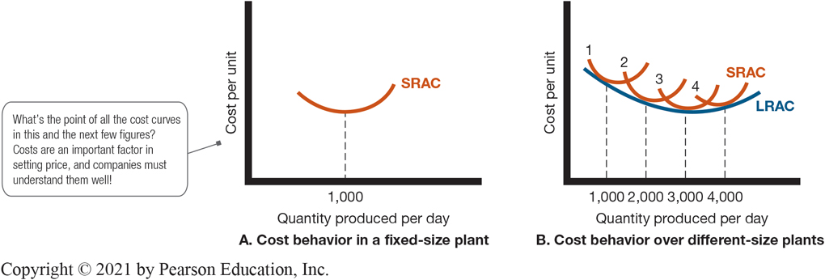
Major Pricing Strategies (12 of 17)
Figure 10.3 Cost per Unit at Different Levels of Production per Period
Notes:
Note to Instructor
It is best to use an example like the Lenovo example given in the book:
Suppose Lenovo has built a plant to produce 1,000 tablet computers per day. Figure 10.3A shows the typical short‑run average cost curve (SRAC). It shows that the cost per tablet computer is high if Lenovo’s factory produces only a few per day. But as production moves up to 1,000 tablet computers per day, average cost falls. This is because fixed costs are spread over more units, with each one bearing a smaller share of the fixed cost. Lenovo can try to produce more than 1,000 tablet computers per day, but average costs will increase because the plant becomes inefficient. Workers have to wait for machines, the machines break down more often, and workers get in each other’s way.
If Lenovo believed it could sell 2,000 tablet computers a day, it should consider building a larger plant. The plant would use more efficient machinery and work arrangements. Also, the unit cost of producing 2,000 tablets per day would be lower than the unit cost of producing 1,000 units per day, as shown in the long‑run average cost (LRAC) curve (Figure 10.3B).
In fact, a 3,000‑capacity plant would even be more efficient, according to Figure 10.3B. But a 4,000-daily production plant would be less efficient because of increasing diseconomies of scale—too many workers to manage, paperwork slowing things down, and so on.
Figure 10.3B shows that a 3,000-daily production plant is the best size to build if demand is strong enough to support this level of production.
Long Description
The line chart in Part A gives the following information:
The x-axis shows "Quantity produced per day." The y-axis shows "Cost per unit."
The chart shows a line that is shaped like a shallow tub. The line is labeled "SRAC." A vertical line from the crest of curve cuts the x-axis at 1,000.
A note tagged to the chart reads "What’s the point of all the cost curves in this and the next few figures? Costs are an important factor in setting price, and companies must understand them well!"
The line chart in Part B gives the following information:
The x-axis shows "Quantity produced per day." The y-axis shows "Cost per unit."
The chart shows 4 shallow tubs. One arm of each tub overlaps another. Each of the curves is labeled "SRAC." A line that connects the crests of all the tubs is labeled "LRAC."
A vertical line from the crests of each of the 4 curves cuts the x-axis at 1000, 2000, 3000, and 4000.

Slide 19
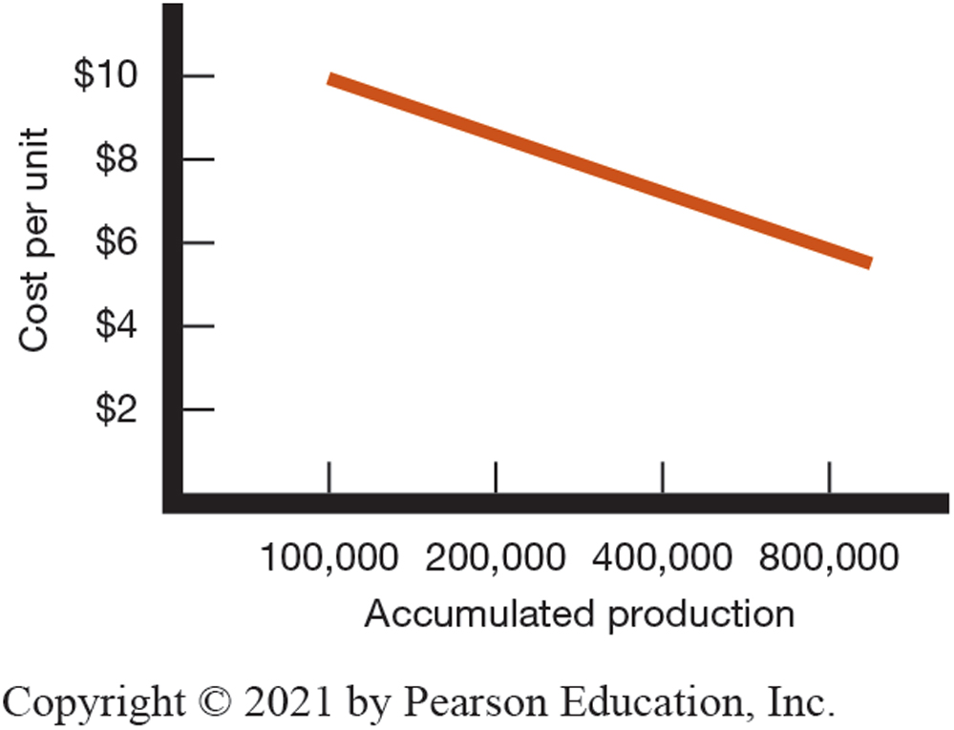
Major Pricing Strategies (13 of 17)
Figure 10.4 Cost per Unit as a Function of Accumulated Production: The Experience Curve
Notes:
Note to Instructor
The Lenovo example continues as follows with Figure 10.4:
Suppose Lenovo runs a plant that produces 3,000 tablets per day. As Lenovo gains experience in producing tablets, it learns how to do it better. This drop in the average cost with accumulated production experience is called the experience curve (or the learning curve).
If a downward-sloping experience curve exists, this is highly significant for the company. Not only will the company’s unit production cost fall, but it will fall faster if the company makes and sells more during a given time period. But the market has to stand ready to buy the higher output. And to take advantage of the experience curve, Lenovo must get a large market share early in the product’s life cycle. This suggests the following pricing strategy: Lenovo should price its calculators low; its sales will then increase, and its costs will decrease through gaining more experience, and then it can lower its prices further. Some companies have built successful strategies around the experience curve.
Long Description
The x-axis of the chart shows "Accumulated production." The values on the y-axis are 100,000, 200,000, 400,000, and 800,000. The y-axis shows "Cost per unit." Its values range from 0 to $10, in increments of $2.
The chart shows a straight line with a negative slope. Approximate values of some of the points on the line are (100,000, $10), (200,000, $8), (800,000, $6).

Slide 20
Major Pricing Strategies (14 of 17)
Cost-Based Pricing
Cost-plus pricing adds a standard markup to the cost of the product.
Benefits
Sellers are certain about costs.
Price competition is minimized.
Buyers feel it is fair.
Disadvantages
Ignores demand and competitor prices
Notes:
The simplest pricing method is cost-plus pricing (or markup pricing). Price is calculated by adding a standard markup to the manufacturer’s costs.
To illustrate markup pricing, suppose a manufacturer of toasters has a cost of $16/unit. If the manufacturer wants to earn a 20 percent markup on sales, the price is calculated by the following:
markup price = unit cost/(1 - desired return on sales) =$16/(1 - .2) = $20
The manufacturer would charge dealers $20 per unit and make a profit of $4 per unit. The dealers, in turn, will mark up the toaster. If dealers want to earn 50 percent on the sales price, they will mark up the toaster to $40 ($20 + 50% of $40). This number is equivalent to a markup on cost of 100 percent ($20/$20).
Does using standard markups to set prices make sense? Generally, no. Any pricing method that ignores demand and competitor prices is not likely to lead to the best price. Still, markup pricing remains popular for many reasons.
Sellers are more certain about costs than about demand.
By tying the price to cost, sellers simplify pricing.
There is no need to make frequent adjustments as demand changes.
If the industry uses this method, prices tend to be similar and price competition is minimized.
Many people feel that cost-plus pricing is fairer to both buyers and sellers.
Sellers earn a fair return but do not take advantage of buyers if demand becomes great.

Slide 21
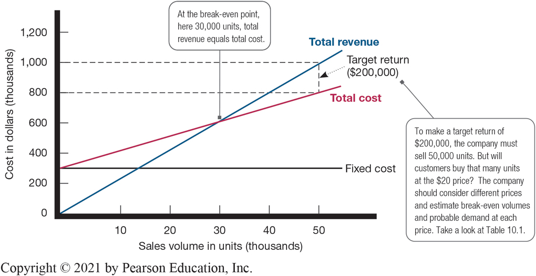
Major Pricing Strategies (15 of 17)
Cost-Based Pricing
Break-even pricing (target return pricing) is setting price to break even on costs or to make a target return.
Figure 10.5 Break-Even Chart for Determining Target Return Price and Break-Even Volume
Notes:
Another cost-oriented pricing approach is break-even pricing (or a variation called target return pricing). The firm tries to determine the price at which it will break even or make the target return it is seeking.
Target return pricing uses the concept of a break-even chart, which shows the total cost and total revenue expected at different sales volume levels.
Long Description
The chart shows "Sales volume in thousands of units" on the x-axis. Its values range from 0 to 50, in increments of 10. The y-axis shows the "Cost in thousands of dollars." Its values range from 0 to 1,200 in increments of 200.
The chart shows three lines - "Total revenue," "Total cost," and "Fixed cost."
The "Fixed cost "line is horizontal and is drawn at y equals 300.
The "Total cost "line starts from 300 on the y-axis and is upward inclined.
The "Total revenue" line starts from (0, 0) and is inclined upward, much steeper than "Total cost" line. A note is tagged to the point of intersection of "Total revenue" and "Total cost." The note reads "At the break-even point, here 30,000 units, total revenue equals total cost."
At a sales volume of 50,000 units, the "Total cost" line shows a cost of $800,000. At the same volume, "Total revenue" is $1,000,000. The gap between the two is labeled "Target return ($200,000)." A note tagged to "Target return" reads "To make a target return of $200,000, the company must sell 50,000 units. But will customers buy that many units at the $20 price? The company should consider different prices and estimate break-even volumes and probable demand at each price. Take a look at Table 10.1."

Slide 22
Major Pricing Strategies (16 of 17)
Table 10.1 Break-Even Volume and Profits at Different Prices
Price | Unit Demand Needed to Break Even | Expected Unit Demand at Given Price | Total Revenue (1) × (3) | Total Costs* | Profit (4) - (5)
$14 | 75,000 | 71,000 | $994,000 | $1,010,000 | –$16,000
16 | 50,000 | 67,000 | 1,072,000 | 970,000 | 102,000
18 | 37,500 | 60,000 | 1,080,000 | 900,000 | 180,000
20 | 30,000 | 42,000 | 840,000 | 720,000 | 120,000
22 | 25,000 | 23,000 | 506,000 | 530,000 | –24,000
*Assumes fixed costs of $300,000 and constant unit variable costs of $10.
Notes:
From the toaster example on the previous two slides, the manufacturer should consider different prices and estimate break-even volumes, probable demand, and profits for each. This is done in Table 10.1. The table shows that as price increases, the break-even volume drops (column 2). But as price increases, the demand for toasters also decreases (column 3).
The manufacturer should consider different prices and estimate break-even volumes, probable demand, and profits for each.

Slide 23

Major Pricing Strategies (17 of 17)
Competition-Based Pricing
Competition-based pricing is setting prices based on competitors’ strategies, costs, prices, and market offerings.
Pricing versus competitors: Caterpillar dominates the heavy equipment industry despite charging premium prices. Customers believe that Caterpillar gives them a lot more value for the price over the lifetime of its machines.
Notes:
Pricing versus competitors: Caterpillar dominates the heavy equipment industry despite charging premium prices. Customers believe that Caterpillar gives them a lot more value for the price over the lifetime of its machines.
Competition-based pricing involves setting prices based on competitors’ strategies, costs, prices, and market offerings. Consumers will base their judgments of a product’s value on the prices that competitors charge for similar products.
In assessing competitors’ pricing strategies, the company should ask:
How does the company’s market offering compare with competitors’ offerings in terms of customer value?
How strong are current competitors and what are their current pricing strategies?

Slide 24
Learning Objective 3
Identify and define the other important external and internal factors affecting a firm’s pricing decisions.
Notes:
Discussion Question
What other issues beyond the market and the economy must marketers consider when setting prices?
Other internal factors that influence pricing decisions include the company’s overall marketing strategy, objectives, and marketing mix, as well as organizational considerations. Price is only one element of the company’s broader marketing strategy. If the company has selected its target market and positioning carefully, then its marketing mix strategy, including price, will be fairly straightforward. Common pricing objectives might include customer retention and building profitable customer relationships, preventing competition, supporting resellers and gaining their support, or avoiding government intervention. Price decisions must be coordinated with product design, distribution, and promotion decisions to form a consistent and effective marketing program. Finally, in order to coordinate pricing goals and decisions, management must decide who within the organization is responsible for setting price.
Other external pricing considerations include the nature of the market and demand and environmental factors such as the economy, reseller needs, and government actions. Ultimately, the customer decides whether the company has set the right price. The customer weighs the price against the perceived values of using the product—if the price exceeds the sum of the values, consumers will not buy. So the company must understand such concepts as demand curves (the price–demand relationship) and price elasticity (consumer sensitivity to prices).
.

Slide 25
Other Considerations Affecting Price Decisions (1 of 7)
Overall Marketing Strategy, Objectives, and Mix
Target costing starts with an ideal selling price based on consumer value considerations and then targets costs that will ensure that the price is met.
Notes:
Companies often position their products on price and then tailor other marketing mix decisions to the prices they want to charge. Here, price is a crucial product-positioning factor that defines the product’s market, competition, and design.
Many firms support such price-positioning strategies with a technique called target costing. Target costing reverses the usual process of first designing a new product, determining its cost, and then asking, “Can we sell it for that?”

Slide 26
Other Considerations Affecting Price Decisions (2 of 7)
Organizational Considerations
Who should set prices?
Who can influence prices?
Notes:
Top management sets the pricing objectives and policies, and it often approves the prices proposed by lower-level management or salespeople.
In industries in which pricing is a key factor (airlines, aerospace, steel, railroads, oil companies), companies often have pricing departments to set the best prices or help others set them. These departments report to the marketing department or top management.
Others who have an influence on pricing include sales managers, production managers, finance managers, and accountants.

Slide 27
Other Considerations Affecting Price Decisions (3 of 7)
The Market and Demand
Before setting prices, the marketer must understand the relationship between price and demand for its products.
Notes:
As noted earlier, good pricing starts with an understanding of how customers’ perceptions of value affect the prices they are willing to pay. Both consumer and industrial buyers balance the price of a product or service against the benefits of owning it.
We now take a deeper look at the price-demand relationship and how it varies for different types of markets. We then discuss methods for analyzing the price-demand relationship.

Slide 28
Other Considerations Affecting Price Decisions (4 of 7)
The Market and Demand
Pricing In Different Types of Markets
Pure competition
Monopolistic competition
Oligopolistic competition
Pure monopoly
Notes:
Discussion Question
Discuss how the internet has changed pricing competition?
Under pure competition, the market consists of many buyers and sellers trading in a uniform commodity, such as wheat, copper, or financial securities. No single buyer or seller has much effect on the going market price. Thus, sellers in these markets do not spend much time on marketing strategy.
Under monopolistic competition, the market consists of many buyers and sellers who trade over a range of prices because sellers can differentiate their offers to buyers.
Under oligopolistic competition, the market consists of only a few large sellers. For example, only four companies—Verizon, AT&T, Sprint, and T-Mobile—control more than 90 percent of the U.S. wireless service provider market. Each seller is alert and responsive to competitors’ pricing strategies and marketing moves.
In a pure monopoly, the market is dominated by one seller. The seller may be a government monopoly (the U.S. Postal Service), a private regulated monopoly (a power company), or a private unregulated monopoly (De Beers and diamonds). Pricing is handled differently in each case.

Slide 29
Other Considerations Affecting Price Decisions (5 of 7)
The Market and Demand
Analyzing the Price–Demand Relationship
The demand curve shows the number of units the market will buy in a given period at different prices.
Demand and price are inversely related
Higher price = lower demand
Notes:
Each price the company might charge will lead to a different level of demand. The relationship between the price charged and the resulting demand level is shown in the demand curve in Figure 10.6. The demand curve shows the number of units the market will buy in a given time period at different prices that might be charged. In the normal case, demand and price are inversely related—that is, the higher the price, the lower the demand. Thus, the company would sell less if it raised its price from P₁ to P₂. In short, consumers with limited budgets probably will buy less of something if its price is too high.

Slide 30
Other Considerations Affecting Price Decisions (6 of 7)
The Market and Demand
Price Elasticity of Demand
Price elasticity is a measure of the sensitivity of demand to changes in price.
Inelastic demand is when demand hardly changes with a small change in price.
Elastic demand is when demand changes greatly with a small change in price.
Notes:
Marketers also need to know price elasticity—how responsive demand will be to a change.
Price elasticity of demand = % change in quantity demand
% change in price
If demand is elastic rather than inelastic, sellers will consider lowering their prices. A lower price will produce more total revenue. This practice makes sense as long as the extra costs of producing and selling more do not exceed the extra revenue.
At the same time, most firms want to avoid pricing that turns their products into commodities in some consumers’ eyes.

Slide 31
Other Considerations Affecting Price Decisions (7 of 7)
The Economy and Other External Factors
Economic conditions
Reseller’s response to price
Government
Social concerns
Notes:
The Economy
Economic conditions can have a strong impact on the firm’s pricing strategies. Economic factors such as a boom or recession, inflation, and interest rates affect pricing decisions because they affect consumer spending, consumer perceptions of the product’s price and value, and the company’s costs of producing and selling a product.
Consumers have tightened their belts and become more value conscious. The most obvious response to the new economic realities is to cut prices and offer discounts. Many companies have done just that to help spur short-term sales. However, lower prices mean lower margins and deep discounts may cheapen a brand in consumers’ eyes. And once a company cuts prices, it’s difficult to raise them again when the economy recovers.
Rather than cutting prices, many companies have instead shifted their marketing focus or added more affordable lines to their product mixes.
Other companies are holding their price positions but redefining the “value” in their value propositions. Remember, even in tough economic times, consumers do not buy based on prices alone. They balance the price they pay against the value they receive. Thus, no matter what price they charge—low or high—companies need to offer great value for the money.
Other External Factors
The company must consider several other factors in its external environment when setting prices.
The company should set prices that give resellers a fair profit, encourage their support, and help them to sell the product effectively.
The government is another important external influence on pricing decisions.
Social concerns may need to be taken into account. In setting prices, a company’s short-term sales, market share, and profit goals may need to be tempered by broader societal considerations.

Slide 32

Copyright
This work is protected by United States copyright laws and is provided solely for the use of instructors in teaching their courses and assessing student learning. Dissemination or sale of any part of this work (including on the World Wide Web) will destroy the integrity of the work and is not permitted. The work and materials from it should never be made available to students except by instructors using the accompanying text in their classes. All recipients of this work are expected to abide by these restrictions and to honor the intended pedagogical purposes and the needs of other instructors who rely on these materials.

